Slide 1
Energy Sales Analysis
File created on: 12-08-2025 11:20:30

Slide 2
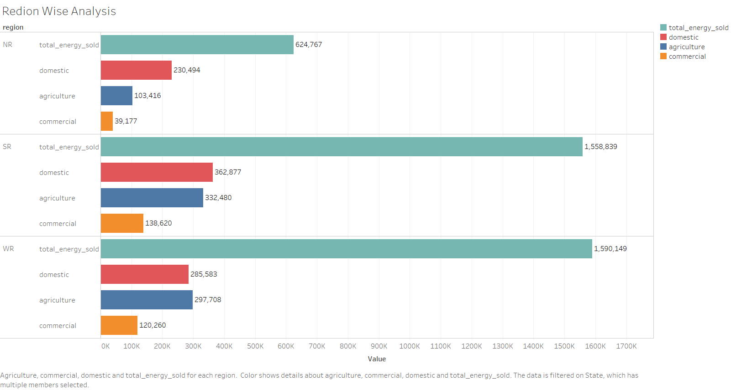

Slide 3
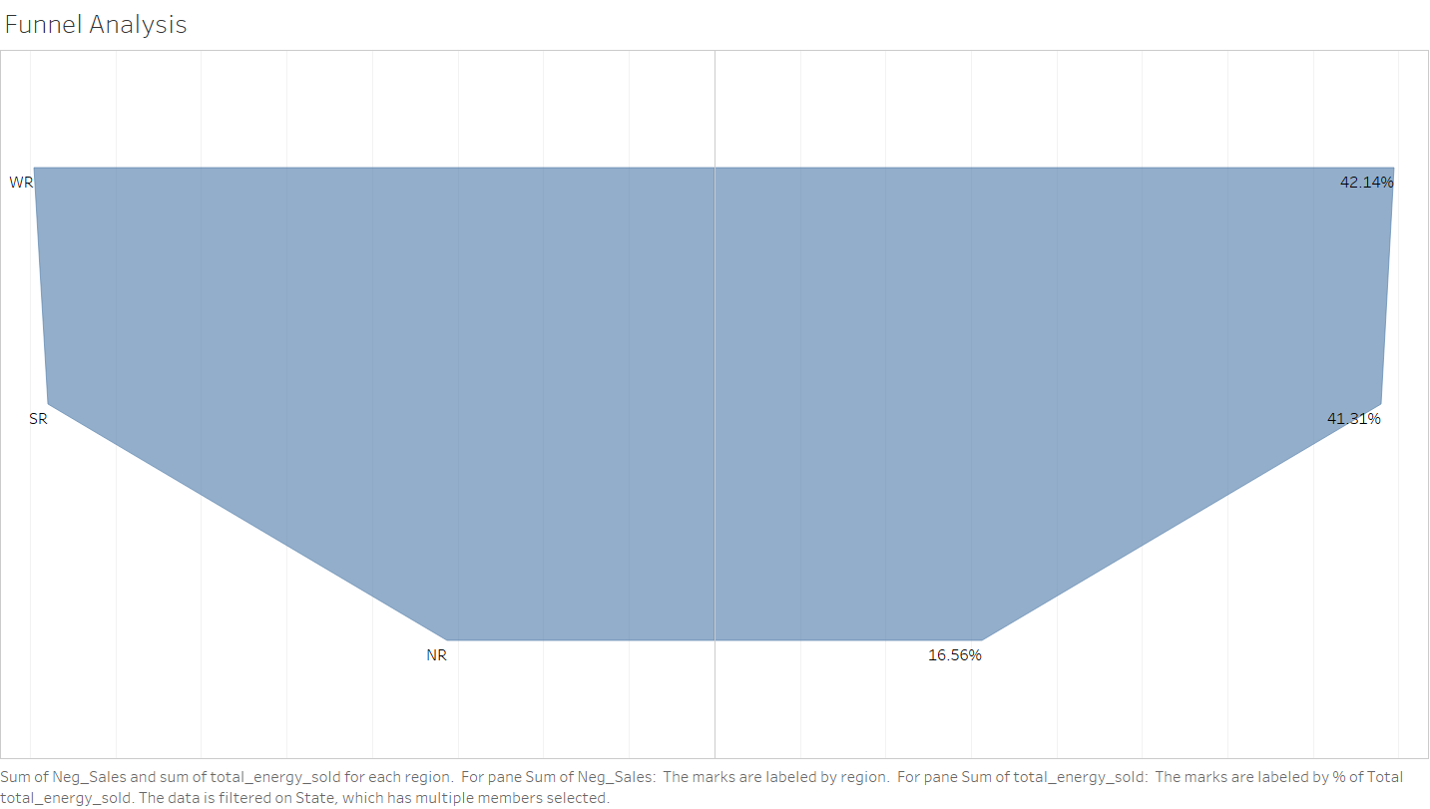

Slide 4
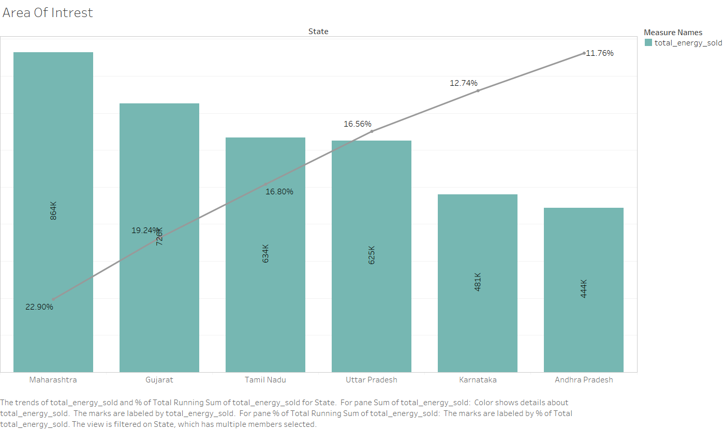

Slide 5
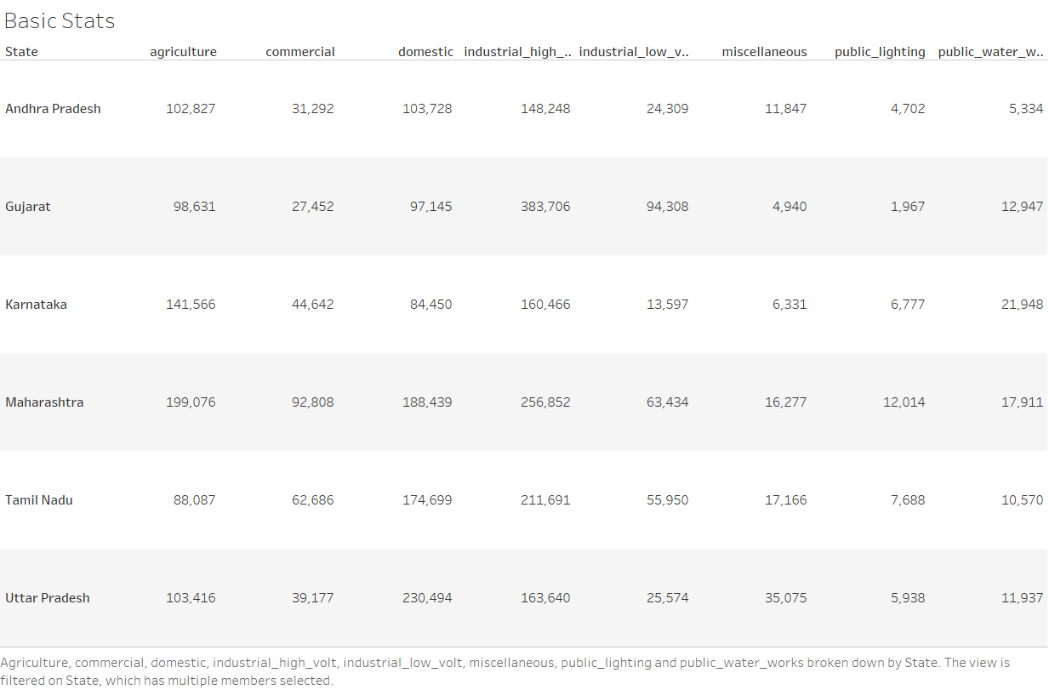

Slide 6
